Slide 1
CMIP Data at NCI
2019 AMOS Darwin
Kate Snow & Jingbo Wang

Slide 2


CMIP Data Introduction
The Coupled Model Intercomparison Project Phase 6 (CMIP6) is the 5th generation of CMIP products from the World Climate Research Programme.
Designed to improve our understanding of past, present and future climate change and its drivers through multi-model developments
Undertaken as an internationally coordinated research activity defining specific target experiments.
Image Source: https://www.earthsystemcog.org/projects/cmip/
© National Computational Infrastructure 2018

Slide 3
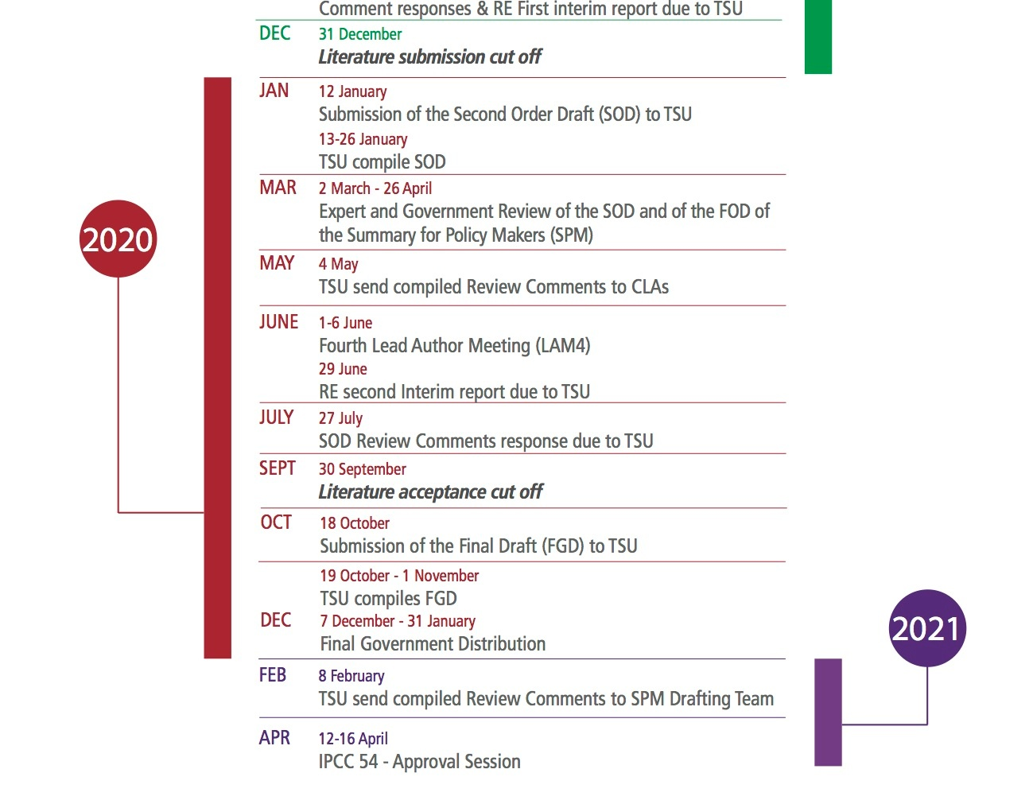
CMIP Data Introduction
The results of CMIP will inform policy makers by provide output that may contribute to the Intergovernmental Panel on Climate Change (IPCC) assessment report.
The data is a core component of the work of many climate scientists, forming a critical component in evaluating the extent and consequence of climate change and extreme events projected for Australia's future.
For the full timeline see the image source: https://wg1.ipcc.ch/AR6/AR6.html
© National Computational Infrastructure 2018

Slide 4

CMIP Data Introduction
CMIP5/6 data, along with a number of other data collections, is distributed via the Earth Systems Grid Federation (ESGF) of distributed data nodes around the planet.
One such data repository is held at NCI and serves the Australian climate community.
© National Computational Infrastructure 2018

Slide 5
CMIP6 Update
Currently only a small subset of replicated CMIP6 data is available under oi10 at NCI. Priority variables have been identified and are automatically replicated with 55TB of data currently downloaded. This data has been republished to the ESGF.
NCI will host Australian data and replicate other models data according to community need.
20 models have started publishing data but over 100 models are registered for CMIP6. Expect community needs for replicated data to be of order 2PB.
© National Computational Infrastructure 2018

Slide 6
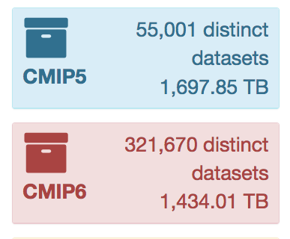
CMIP6 Additional FAQ
CMIP6 contributions from modelling centres expected to continue throughout 2019 and into 2020.
The CMIP6 datasets will continue to grow for some time. Already nearly surpassing the CMIP5 volumes (http://esgf-ui.cmcc.it:8080/esgf-dashboard-ui/pages/index.html)
Over 100 models, 287 experiments, expected 18PB.
© National Computational Infrastructure 2018

Slide 7
CMIP6 Update
Two Australian ACCESS models are registered for CMIP6 contributions:
ACCESS-CM2
Potential additional MIPs: OMIP, FAFMIP, RFMIP and ScenarioMIP
ACCESS-ESM1-5
Potential additional MIPs: C4MIP, CDRMIP, OMIP, RFMIP and ScenarioMIP.
Contributions from these models expected to start being published Q3/Q4 2019.
© National Computational Infrastructure 2018

Slide 8
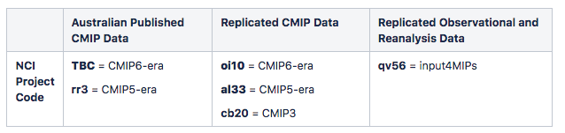
CMIP Projects and Access
NCI host CMIP3, CMIP5 and CMIP6 data collections. To access the data at NCI you need to register for the correct projects and agree to the terms and conditions for the data collections.
Request to join a data collection through my.nci.org.au/mancini.
© National Computational Infrastructure 2018

Slide 9
CMIP Terms of Use and Citation
When you request to join a CMIP project, your request is sent to the data collection manager for approval and you must agree to the Terms and Conditions that govern CMIP data access.
CMIP6 Terms of Use
CMIP5 Terms of Use
For general CMIP5 citation information please refer to the CMIP5 citation recommendations .
© National Computational Infrastructure 2018

Slide 10
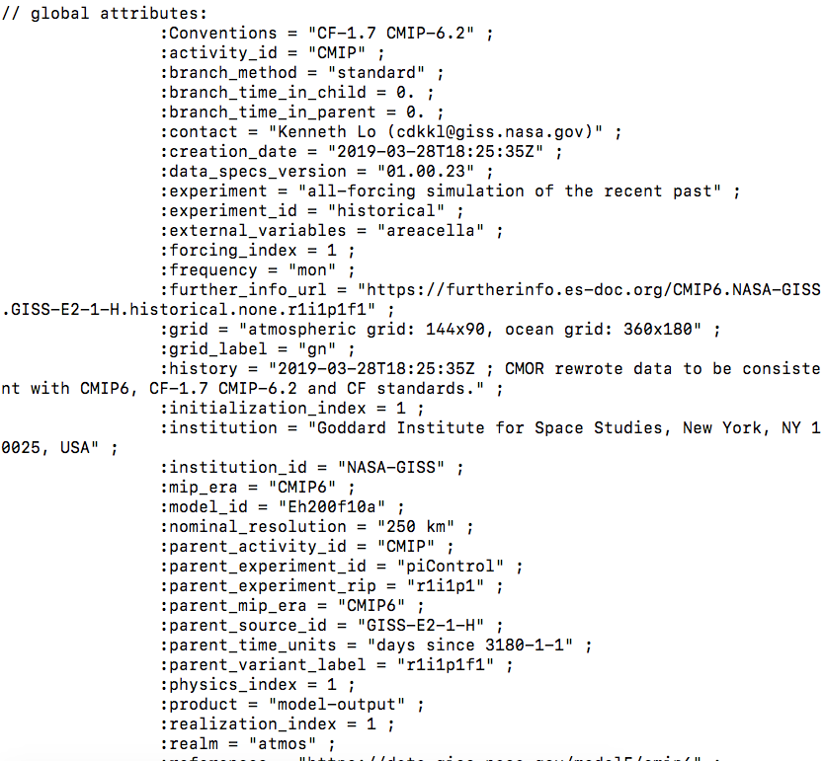
CMIP6 Terms of Use and Citation
For CMIP6 citation information refer to the CMIP Citation Recommendations .
Note a user is required to:
1. Cite CMIP6 data in the reference list of your scholarly publication, and
2. register your publication at the CMIP Publication Site.
CMIP6 data citations can be accessed from the further_info_url available in the metadata within each netCDF data file.
© National Computational Infrastructure 2018

Slide 11
CMIP Projects and Access
Two types of CMIP data: Published (rr3) and Replicated (al33, oi10).
Published = Australian model output for which NCI is the primary publisher of the data (e.g. ACCESS1-0, ACCESS1-3, etc). On the filesystem this follows the format /g/data/<project>/publications/
Replicated = Data that NCI has downloaded from other international sources (e.g. the GISS models published to the NASA node). On the filesystem this follows the format /g/data/<project>/replicas/
© National Computational Infrastructure 2018

Slide 12
CMIP DRS
All CMIP data follow standard rules and formats defined by the ESGF. In particular, relating to
directory structure (DRS)
filenames
metadata attributes and versioning
All CMIP data is CF Compliant and of netCDF format to permit interdisciplinary research.
Understanding the CMIP terminology and facets will help in your future search and analysis (for example, CleF runs searches based on attribute/facet names.)
© National Computational Infrastructure 2018

Slide 13
CMIP Directory Structure
To permit interdisciplinary research, CMIP uses a standard naming convention for files, directories, metadata and URLs. These conventions are described in detail the CMIP6 Controlled Vocabularies and CMIP5 Controlled Vocabularies
CMIP6/<activity_id>/<institution_id>/<source_id>/<experiment_id>/<member_id>/<table_id>/<variable>/<grid_label>/<version>
CMIP5/<product>/<institute>/<model>/<experiment>/<frequency>/<realm>/<table>/<ensemble>/<version>/<variable>
© National Computational Infrastructure 2018

Slide 14
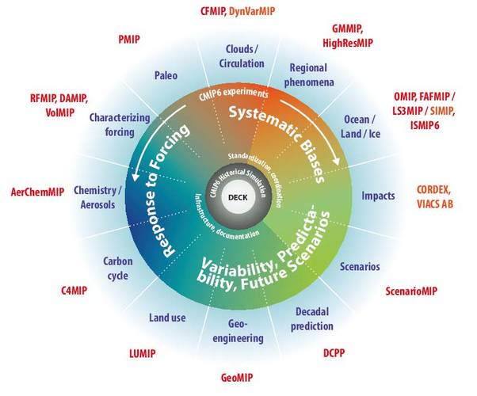
CMIP6 Directory Structure
activity_id = the Model Intercomparison Project or MIP (e.g. CMIP, GeoMIP)
MIP definitions have changed from CMIP5 along with the experiments they define
“CMIP6” now defines the MIP era and experiments are divided into MIPs. E.g. CMIP, GeoMIP, ScenarioMIP, etc. “CMIP” covers the DECK and historical runs, totalling ONLY 11 experiments.
Total 23 Endorsed MIPs
© National Computational Infrastructure 2018
Notes:
“CMIP” covers the core Diagnostic, Evaluation and Characterization of Klima (DECK: AMIP, piControl, 1pctCO2, abrupt-4xCO2) and historical experiments.

Slide 15
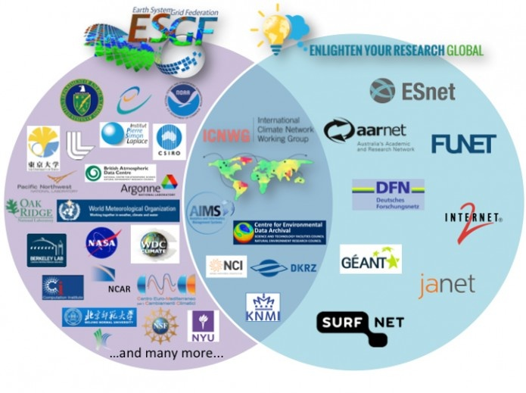
CMIP6 Directory Structure
institution_id = publication centre (e.g. NASA-GISS, CSIRO)
All registered institutes can be found in the CMIP6 CV Table
Image source https://icnwg.llnl.gov/sites/default/files/Slide1.png
© National Computational Infrastructure 2018

Slide 16
CMIP6 Directory Structure
source_id = model name (e.g. ACCESS-CM2, CESM2)
All registered models (whether data has been published yet or not) can be found in the CMIP6 CV Table
Currently 113 models registered (May 2019).
© National Computational Infrastructure 2018

Slide 17
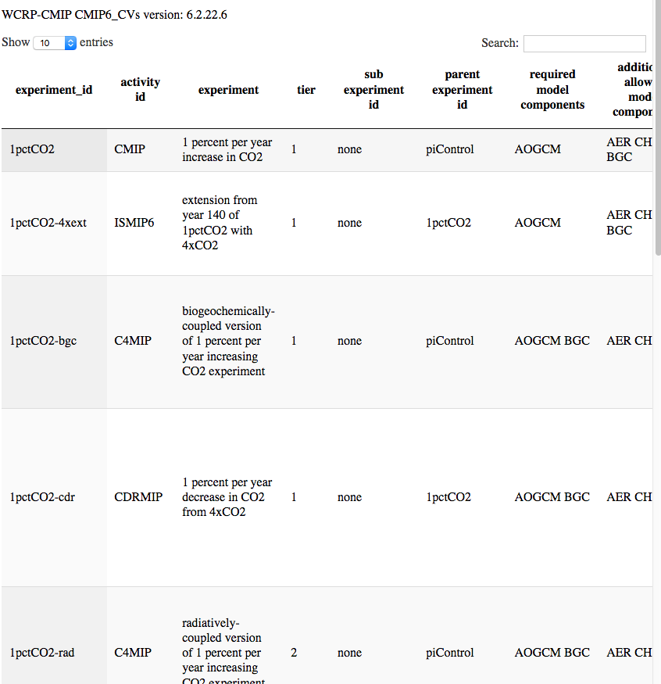
CMIP6 Directory Structure
experiment_id = experiment run (e.g historical, amip)
Information on all experiments within a MIP are explained in the GMD Special Issue
Summary of all exps: CMIP6 CV Table
© National Computational Infrastructure 2018

Slide 18
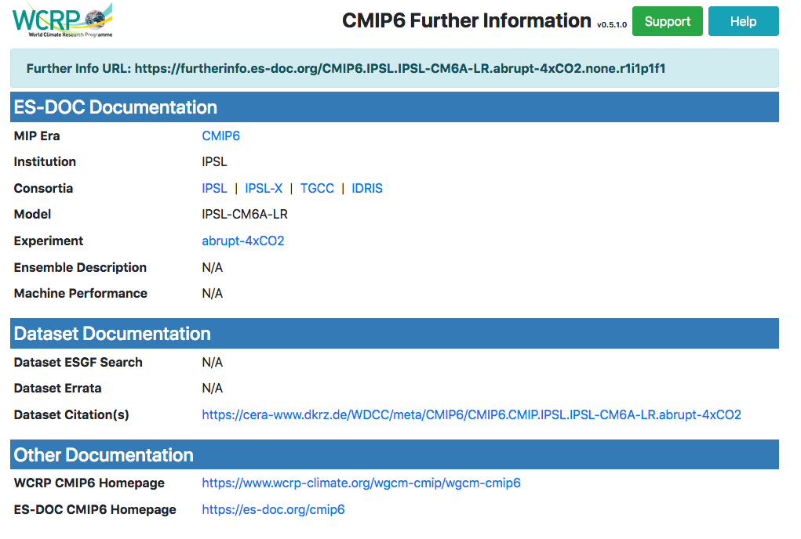
CMIP6 Directory Structure
member_id = ripf number (r=realization, i=initialization, p=physics, f=forcing).
Information on the ripf can be found in the netCDF file attribute called “further_info_URL” which provides a landing page of relevant (under development) documentation for that dataset.
© National Computational Infrastructure 2018
Notes:
realization_index = an integer (≥1) distinguishing among members of an ensemble of simulations that differ only in their initial conditions (e.g., initialized from different points in a control run). Note that if two different simulations were started from the same initial conditions, the same realization number should be used for both simulations. For example if a historical run with “natural forcing” only and another historical run that includes anthropogenic forcing were both spawned at the same point in a control run, both should be assigned the same realization. Also, each so-called RCP (future scenario) simulation should normally be assigned the same realization integer as the historical run from which it was initiated. This will allow users to easily splice together the appropriate historical and future runs.
initialization_index = an integer (≥1), which should be assigned a value of 1 except to distinguish simulations performed under the same conditions but with different initialization procedures. In CMIP6 this index should invariably be assigned the value “1” except for some hindcast and forecast experiments called for by the DCPP activity. The initialization_index can be used either to distinguish between different algorithms used to impose initial conditions on a forecast or to distinguish between different observational datasets used to initialize a forecast.
physics_index = an integer (≥1) identifying the physics version used by the model. In the usual case of a single physics version of a model, this argument should normally be assigned the value 1, but it is essential that a consistent assignment of physics_index be used across all simulations performed by a particular model. Use of “physics_index” is reserved for closely-related model versions (e.g., as in a “perturbed physics” ensemble) or for the same model run with slightly different parameterizations (e.g., of cloud physics). Model versions that are substantially different from one another should be given a different source_id” (rather than simply assigning a different value of the physics_index).
forcing_index = an integer (≥1) used to distinguish runs conforming to the protocol of a single CMIP6 experiment, but with different variants of forcing applied. One can, for example, distinguish between two historical simulations, one forced with the CMIP6-recommended forcing data sets and another forced by a different dataset, which might yield information about how forcing uncertainty affects the simulation.

Slide 19
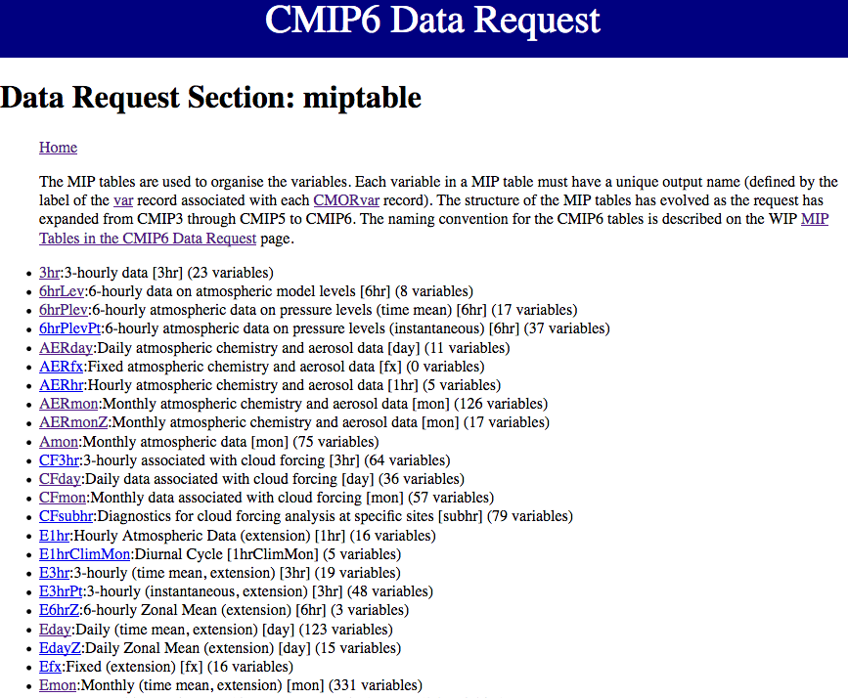
CMIP6 Directory Structure
table_id = defines realm and frequency (e.g. Amon = atmospheric monthly)
Information on the table_id definitions as well as other terms can be found on the CMIP6 Data Request page: MIP Table_ids
© National Computational Infrastructure 2018

Slide 20
CMIP6 Directory Structure
grid_label provides information on the grids. For example, gn = native grid, gr = regridded, etc.
All grid options defined by the Controlled Vocabulary table: CMIP6 CV Table
version is the date the data was published.
For example v20190202 means the data was published on 2nd February 2019.
© National Computational Infrastructure 2018

Slide 21
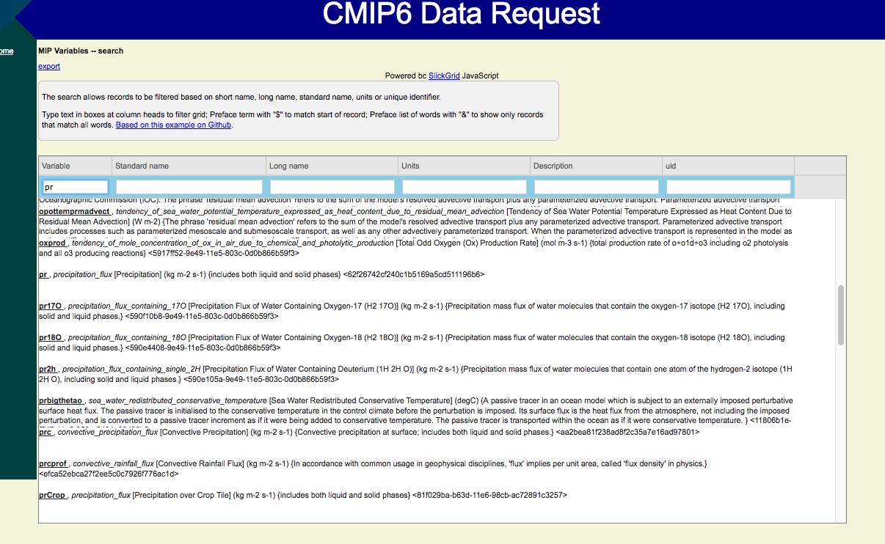
CMIP6 Directory Structure
variable_id = the name of the variable following CMOR conventions
> 2000 variables
If unsure what a variable is you can search it’s definition here: http://clipc-services.ceda.ac.uk/dreq/mipVars.html
© National Computational Infrastructure 2018

Slide 22
CMIP Directory Structure
CMIP6/<activity_id>/<institution_id>/<source_id>/<experiment_id>/<member_id>/<table_id>/<variable_id>/<grid_label>/<version>
Example:
/g/data/oi10/replicas/CMIP6/CMIP/NASA-GISS/GISS-E2-1-G/historical/r1i1p1f1/Amon/pr/gn/v20180827/
/activity_id / institute_id / source_id
/ experiment_id / member_id / table_id / var / grid / version
© National Computational Infrastructure 2018

Slide 23
CMIP6 vs CMIP5 Attributes
1. CMIP6 added forcing to the ripf value, while CMIP5 only includes realization, initialisation and physics indices.
CMIP6 example:
/g/data/oi10/replicas/CMIP6/CMIP/NASA-GISS/GISS-E2-1-G/historical/r1i1p1f1/Amon/pr/gn/v20180827
CMIP5 example:
/g/data/al33/replicas/CMIP5/combined/NASA-GISS/GISS-E2-H/historical/mon/atmos/Amon/r1i1p1/v20160426/pr
© National Computational Infrastructure 2018

Slide 24
CMIP6 vs CMIP5 Attributes
2. CMIP6 removed the frequency (mon) and realm (atmos) attributes as this information is all contained in the table_id (Amon) anyway.
CMIP6 example:
/g/data/oi10/replicas/CMIP6/CMIP/NASA-GISS/GISS-E2-1-G/historical/r1i1p1f1/Amon/pr/gn/v20180827
CMIP5 example:
/g/data/al33/replicas/CMIP5/combined/NASA-GISS/GISS-E2-H/historical/mon/atmos/Amon/r1i1p1/v20160426/pr
© National Computational Infrastructure 2018

Slide 25
CMIP6 vs CMIP5 Attributes
3. CMIP6 datasets are defined at the variable level.
CMIP6 version after variable:
/g/data/oi10/replicas/CMIP6/CMIP/NASA-GISS/GISS-E2-1-G/historical/r1i1p1f1/Amon/pr/gn/v20180827
CMIP5 version before variable:
/g/data/al33/replicas/CMIP5/combined/NASA-GISS/GISS-E2-H/historical/mon/atmos/Amon/r1i1p1/v20160426/pr
© National Computational Infrastructure 2018

Slide 26
CMIP3 Directory Structure
CMIP3 follows similar directory structure. CMIP3 is in project cb20.
CMIP6 example:
/g/data/oi10/replicas/CMIP6/CMIP/NASA-GISS/GISS-E2-1-G/historical/r1i1p1f1/Amon/pr/gn/v20180827
CMIP5 example:
/g/data/al33/replicas/CMIP5/combined/NASA-GISS/GISS-E2-H/historical/mon/atmos/Amon/r1i1p1/v20160426/pr
CMIP3 example:
/g/data/cb20/replicas/cmip3/NASA-GISS/giss_model_e_ h/historical/mon/atmos/run1/pr/v1/
© National Computational Infrastructure 2018
Notes:
cmip3/<institute>/<model>/<experiment>/<frequency>/<realm>/<member>/<variable>/<version>/

Slide 27
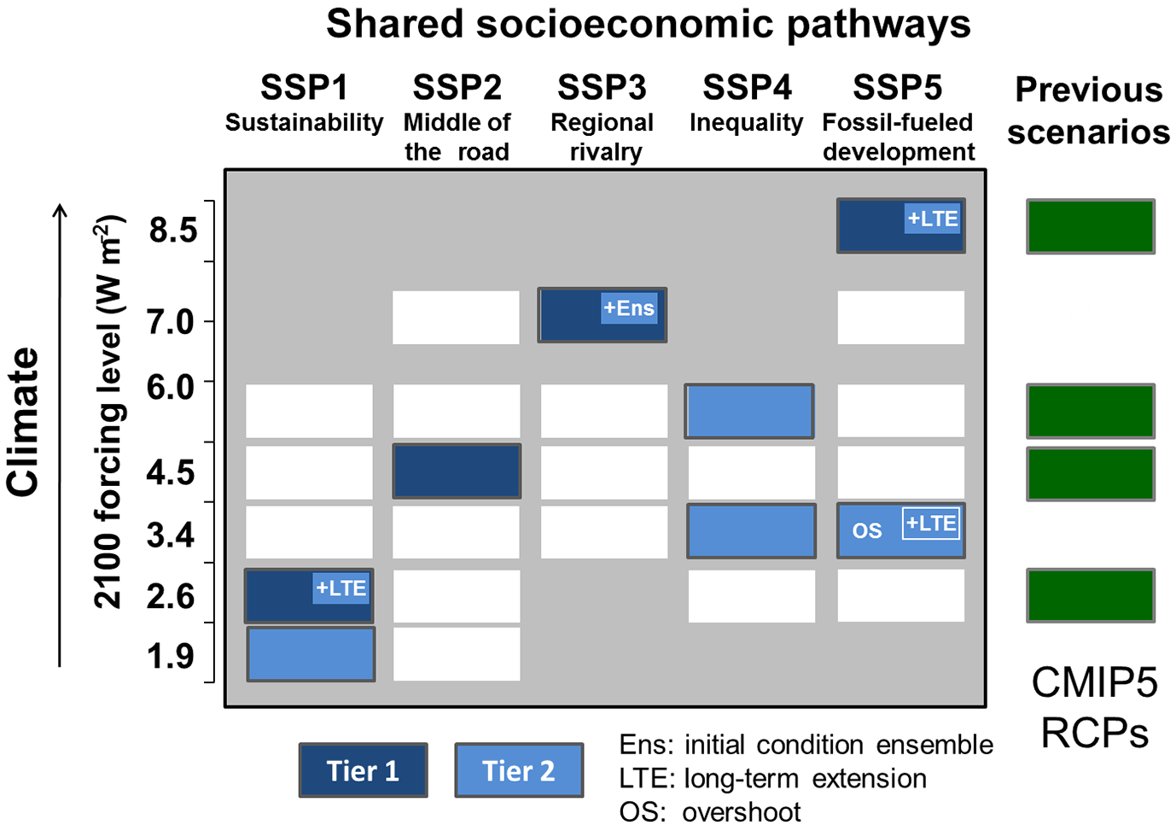
CMIP5 vs CMIP6 Changes
Some experiment names/definitions have changed from CMIP5 to CMIP6.
Key example is the CMIP5 Representative Concentration Pathway (rcp) experiments which have been replaced by Shared Socioeconomic Pathways (ssp)
© National Computational Infrastructure 2018

Slide 28
CMIP5 vs CMIP6 Changes
Names of variables or experiments may have changed or be no longer available.
Experiment
abrupt4xCO2 → abrupt-4xCO2
Variable
Sea-ice examples
sic → siconc
sit → sithick
© National Computational Infrastructure 2018

Slide 29
CMIP6 Retracted Data
Due to the developmental nature CMIP6, it is expected that some published datasets may be later found to have erroneous characteristics.
To ensure a clear and discoverable management of errata for CMIP6 data, an errata service has been developed by Earth System Documentation (ES-Doc) to record such errata.
Affected datasets at NCI are recorded here
Users will be notifies of all data retractions or errors for NCI hosted data as they are recorded.
© National Computational Infrastructure 2018

Slide 30
Searching CMIP data
The CMIP data hosted at NCI can be accessed directly on the filesystem via Raijin or the VDI.
Due to the complexity and volume of the CMIP datasets, manual searching and accessing the data you are after is highly inefficient and difficult. We thus recommend using the CleF tool developed by CLEX for all CMIP5 and CMIP6 data search needs.
Examples to follow in jupyter notebook.
© National Computational Infrastructure 2018
Notes:
cmip3/<institute>/<model>/<experiment>/<frequency>/<realm>/<member>/<variable>/<version>/

Slide 31
Other Useful Resources
CMIP6 Guidance for Data Users: https://pcmdi.llnl.gov/CMIP6/Guide/dataUsers.html#1-experiment-design
Earth-System Documentation (ES-DOC): https://es-doc.org/cmip6/
CMIP5 PCMDI Site Information: https://pcmdi.llnl.gov/mips/cmip5/
World Climate Research Programme: https://www.wcrp-climate.org/wgcm-cmip
Journal article, Overview of CMIP6, Eyring et al., 2016, https://www.geosci-model-dev.net/9/1937/2016/
© National Computational Infrastructure 2018

